Slide 1
Group 10
Sprint3

Slide 2
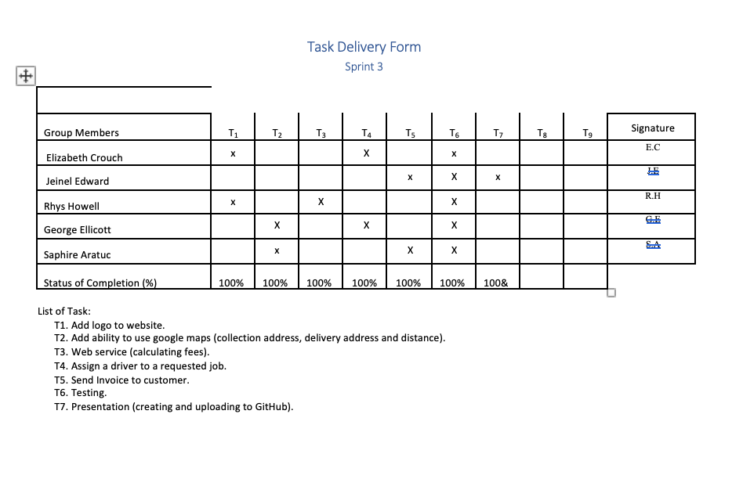
Roles and task Allocation

Slide 3
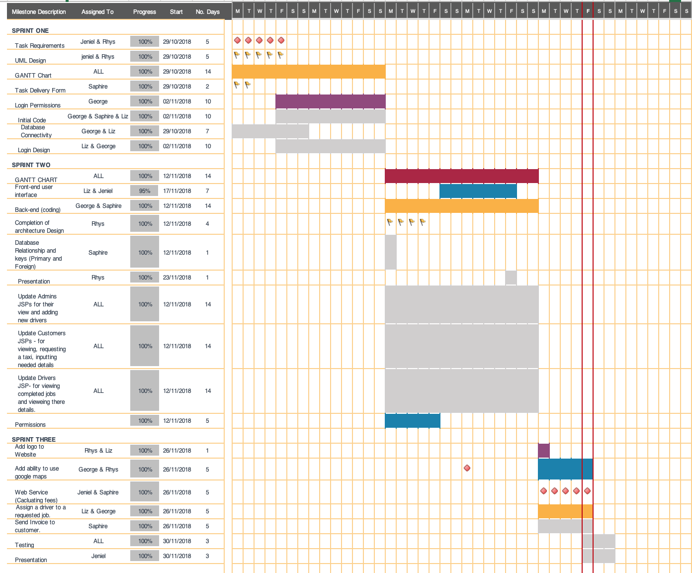
Gant Chart

Slide 4
Scrum 1
Identify tasks for sprint 3.
Allocate tasks to group members.
Create new task delivery form.
Added logo to website.
Discussed the implementation of google maps and how to calculate distance of journey.

Slide 5
Scrum 2
Updated the Gantt chart.
Discussed work done and what was left to be completed.
Checked program against some of the test cases.
Discussed how the fee would be calculated.
Discussed how the invoice would be sent to the customer.

Slide 6
Scrum 3
Tested the program against test cases.
Error tested the system.
Completed Gantt chart.
Finished presentation.

Slide 7
Link to github project
https://github.com/george98788/Enterprise-systems-development

